Slide 1

Food Delivery Time Prediction
By Jordan Allwood, Krystal Moore-Gayle, Amily Jabr, Jonathan Gyure, and Jeet Shah

Slide 2
Defining a Business Problem
In a time where food delivery is very common, determining an accurate delivery time is important for the customer, delivery company, and restaurants.
Speed of delivery is an influential factor when measuring customer satisfaction (ACSI Restaurant and Food Delivery Study, 2024).
Our research aims to predict the final food delivery time given a range of predictors.

Slide 3


Data Collection/Preparation

Slide 4
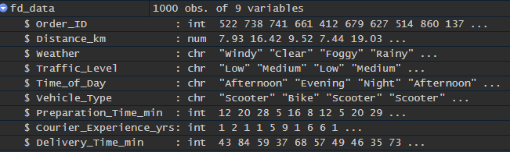
Data Description
Simulated data set obtained from Kaggle.com
1000 observations
Response Variable: Delivery Time (min); continuous
Explanatory Variables:
Preparation Time (min), Distance (km); continuous
Order ID; discrete
Weather, Vehicle Type, Time of Day; nominal
Courier Experience (yrs), Traffic Level; ordinal

Slide 5
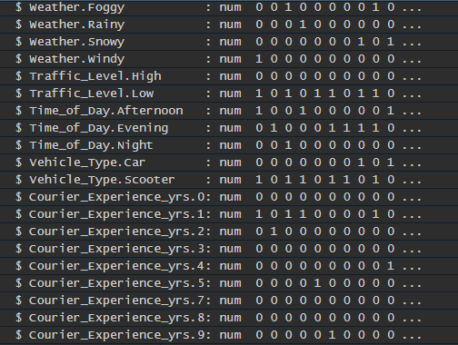
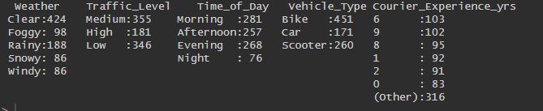
Cleaning the Data
Deleted rows that contained blank/NA values
Checked for duplicate observations
Checked for suspicious observations
Removed unnecessary variable: Order ID
Factor conversion
Binarization of Variables
Relevel Factor Variables

Slide 6


Exploratory Data Analysis

Slide 7
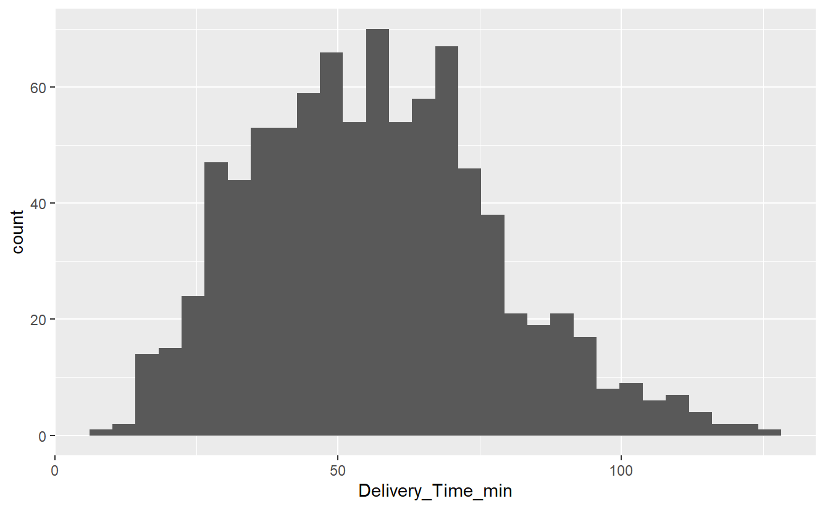
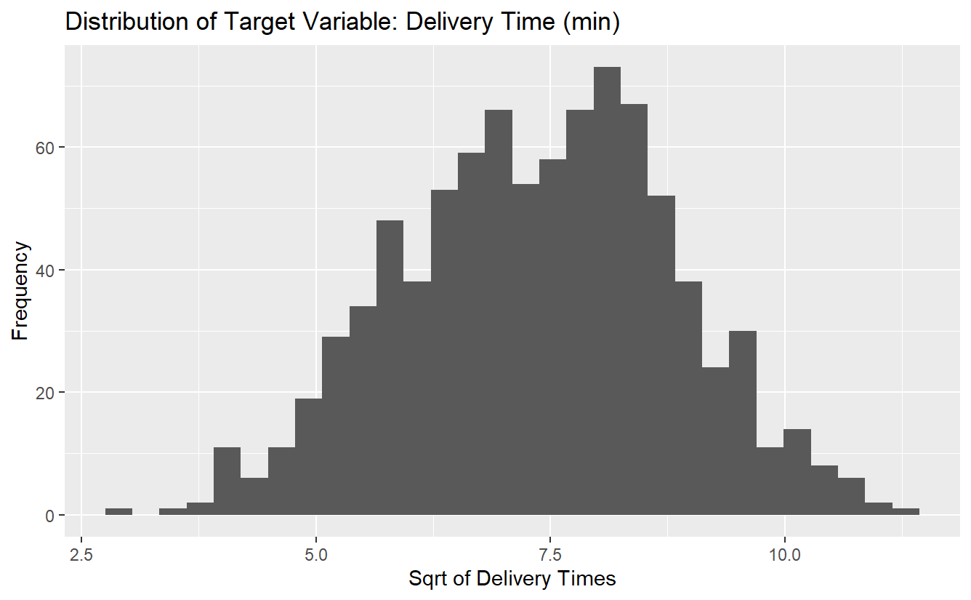
Transformation of Target Variable
Original
Square Root Transformation

Slide 8
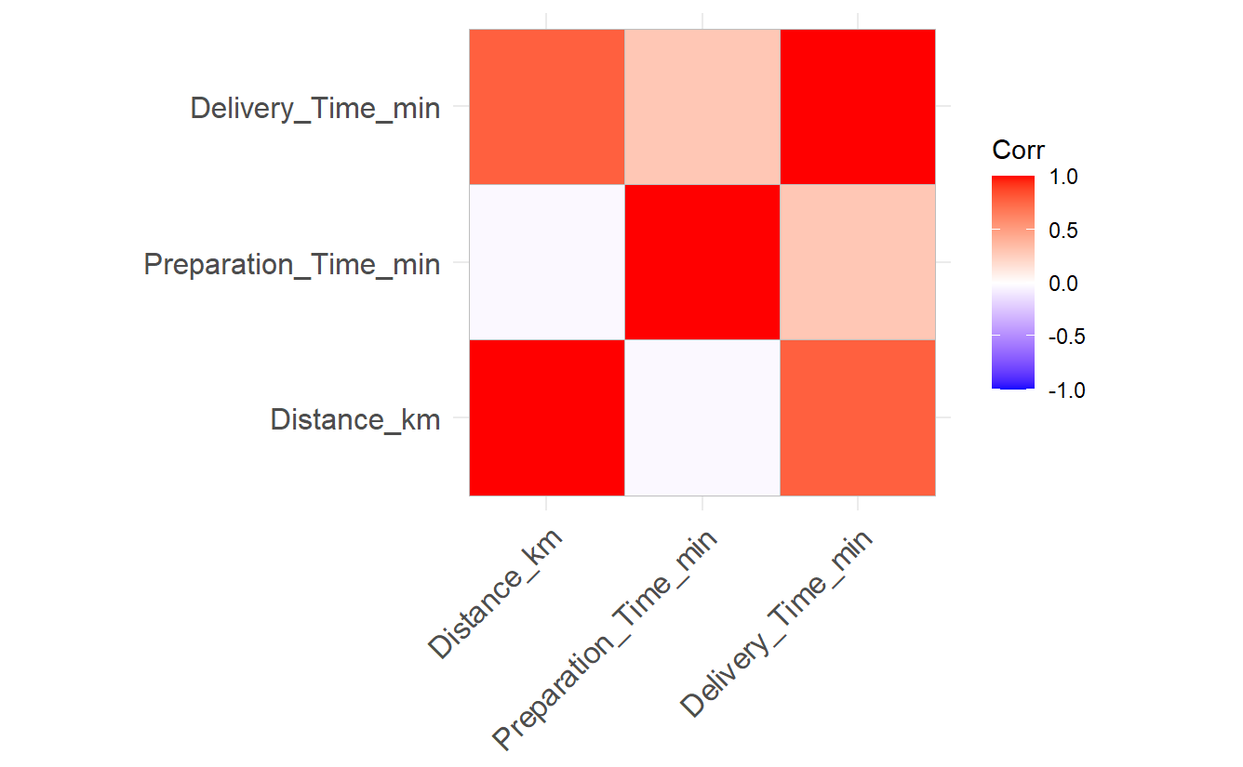
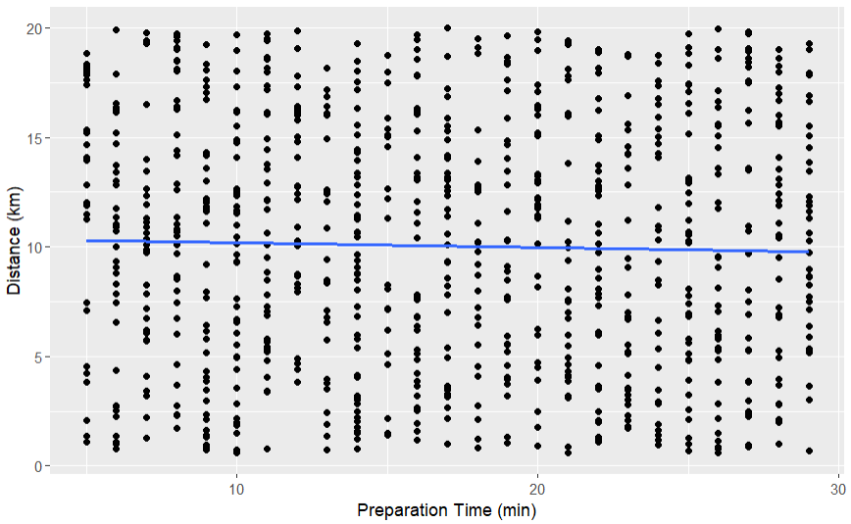
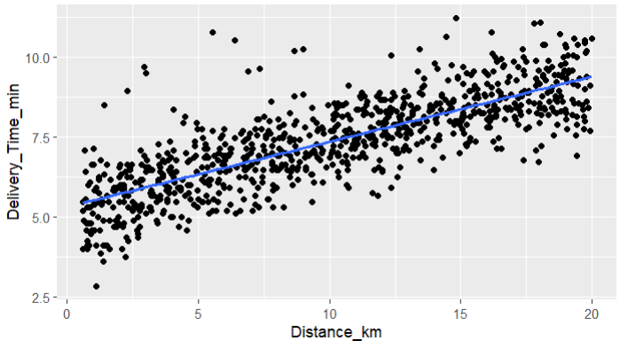
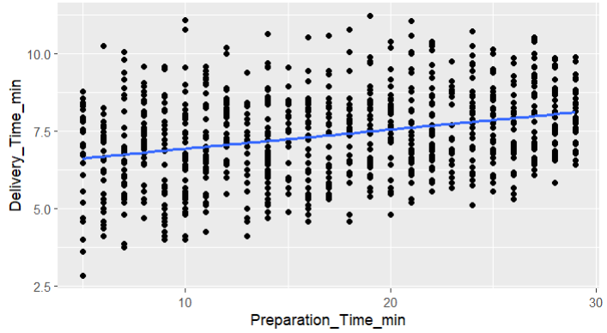
Relationships Between Numeric Predictors and Target Variable
Delivery Time and Distance: 0.7959
Delivery Time and Preparation Time: 0.3092
Distance and Preparation Time: -0.0275

Slide 9
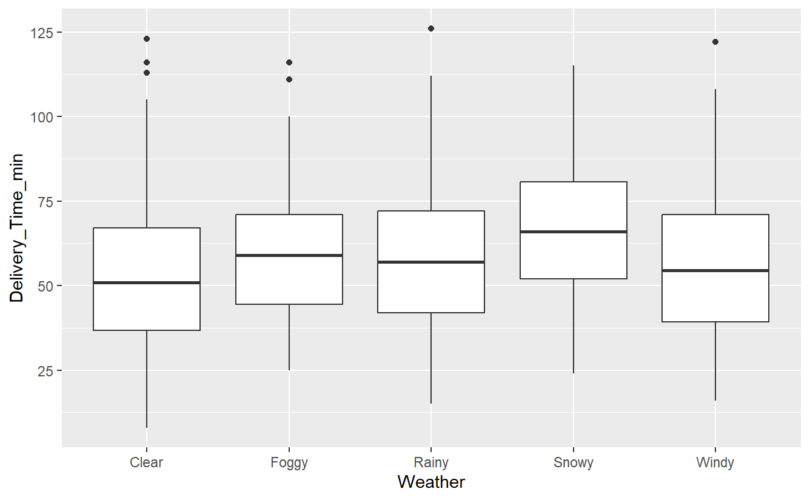
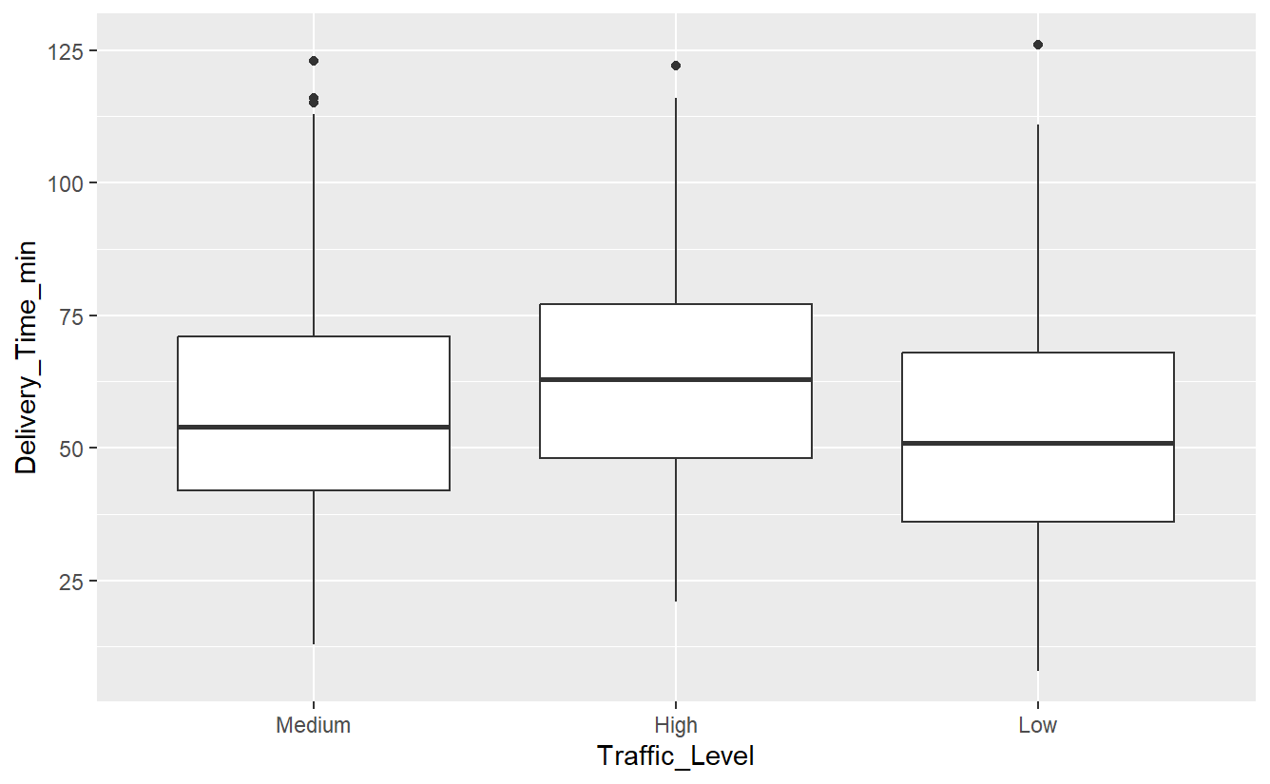
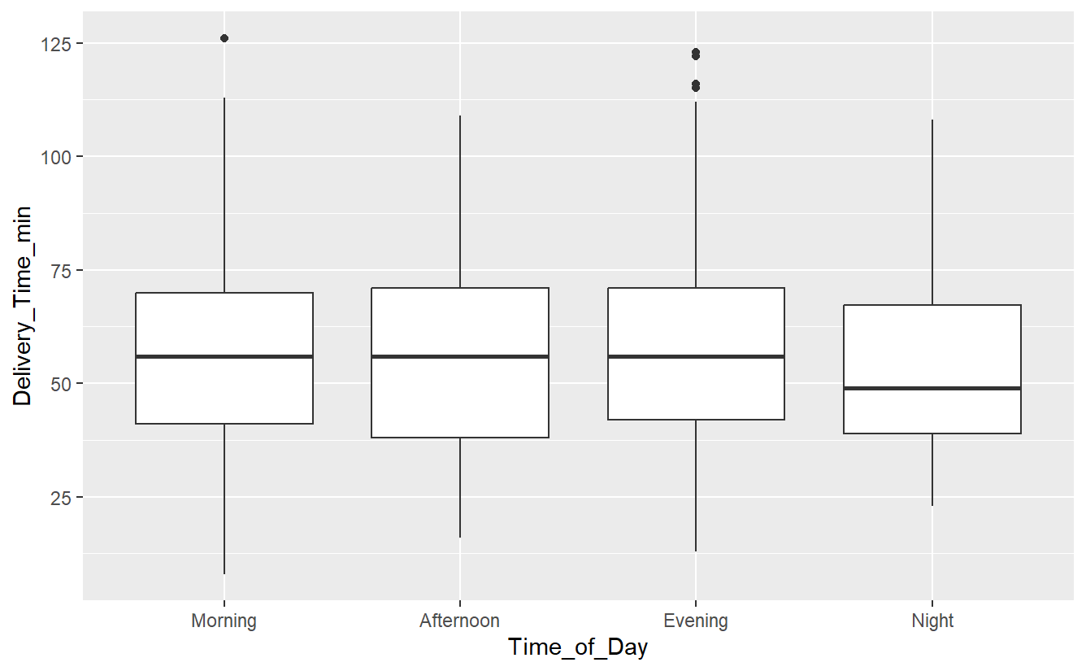
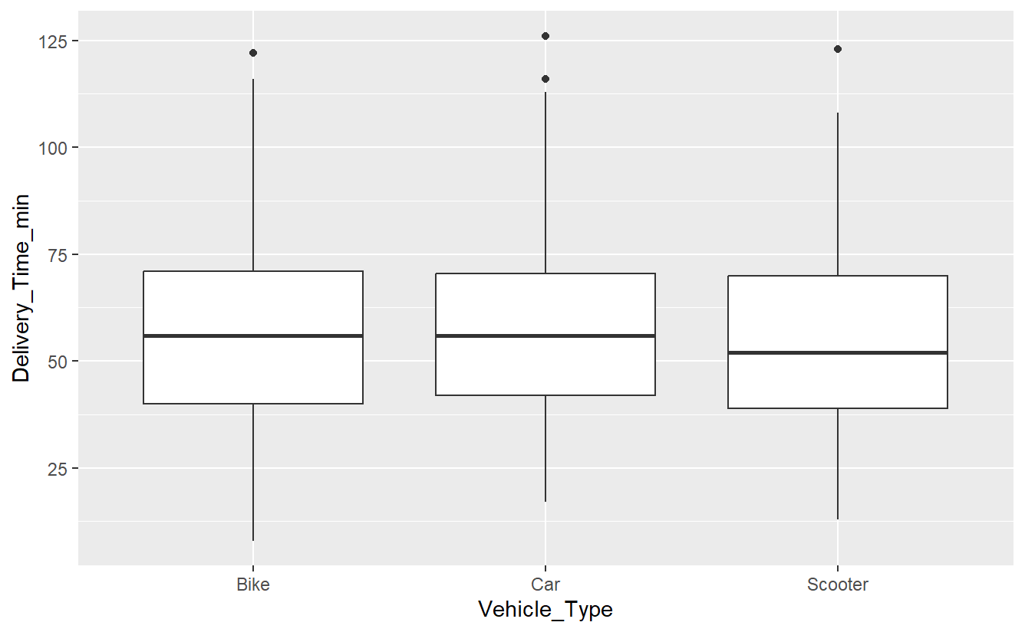
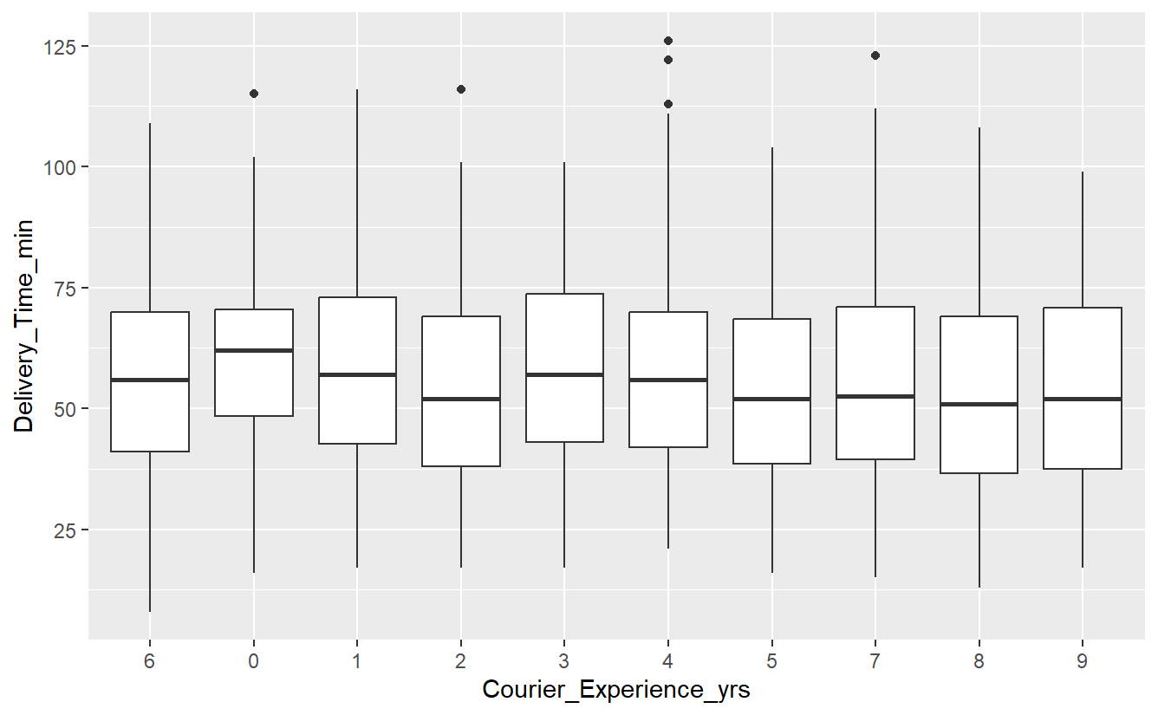
Identifying Significant Categorical Predictors

Slide 10
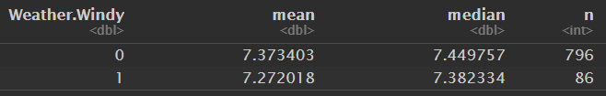
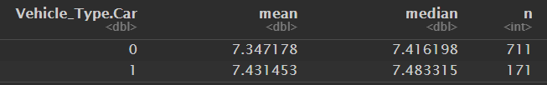
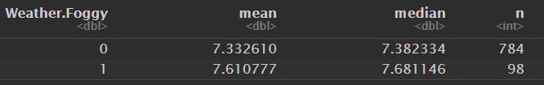
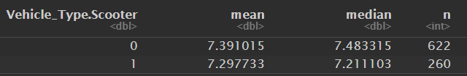
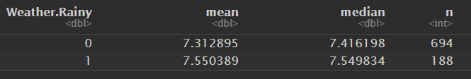

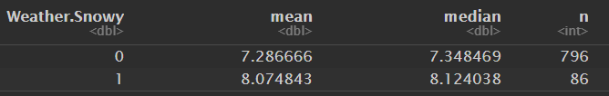
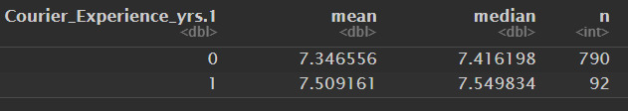
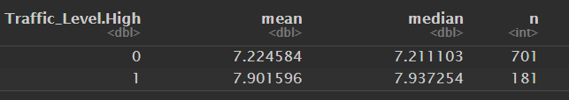
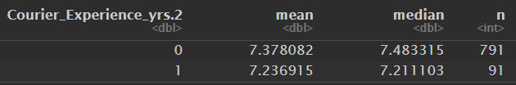

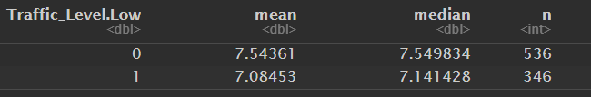
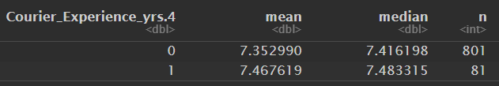
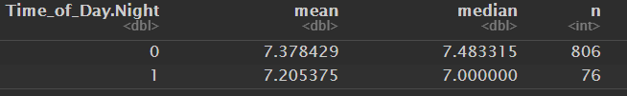
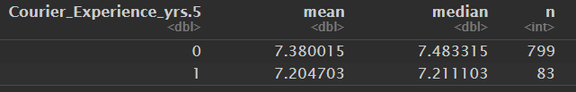
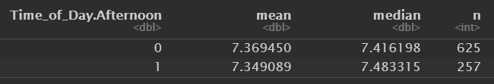
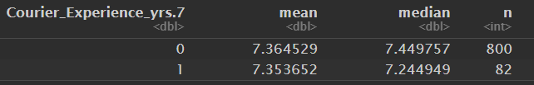
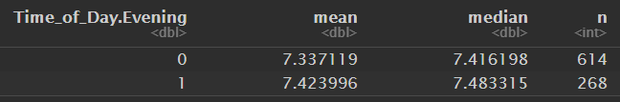
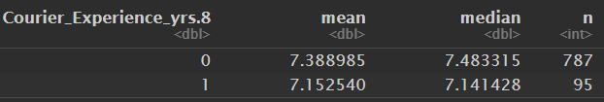
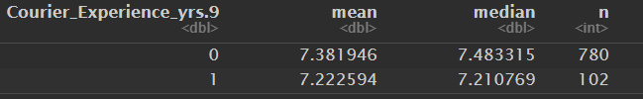
Identifying Significant Categorical Predictors

Slide 11
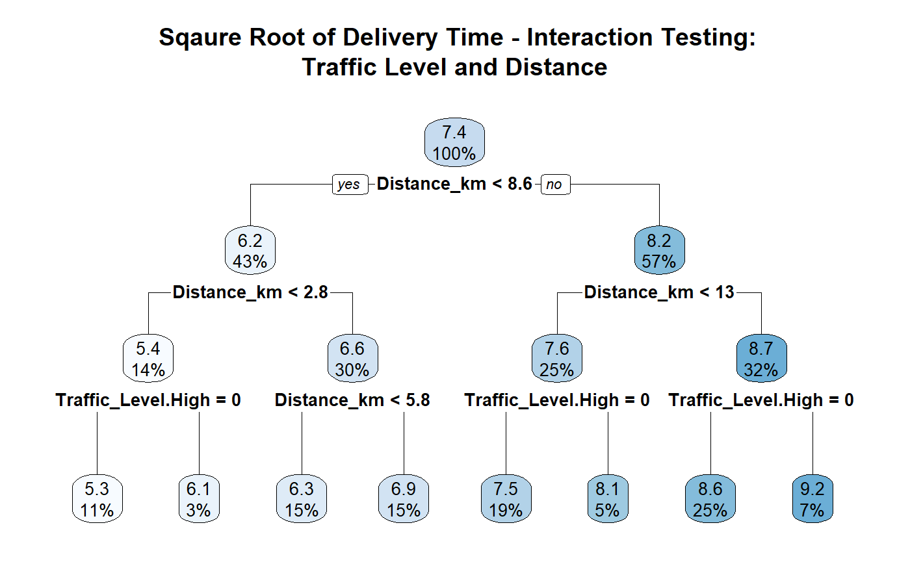
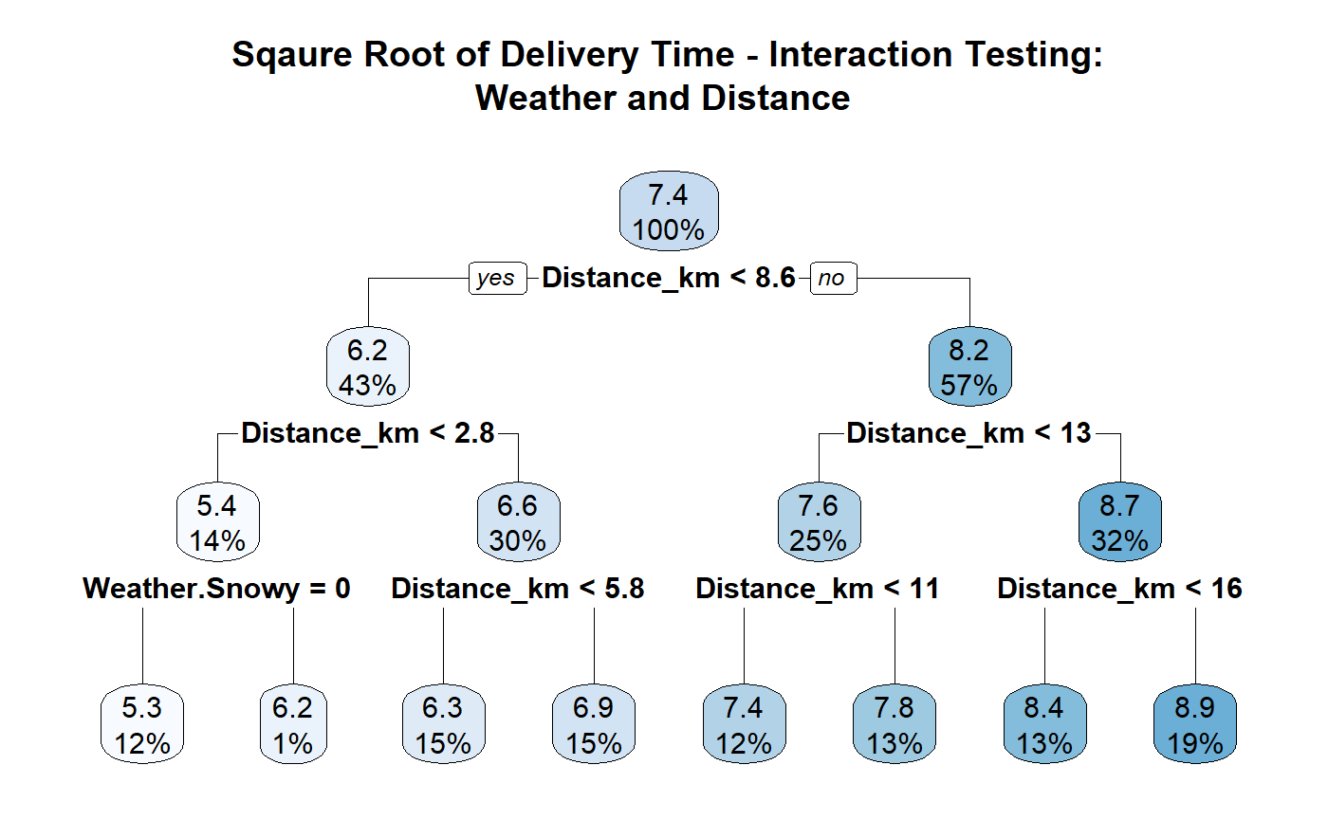
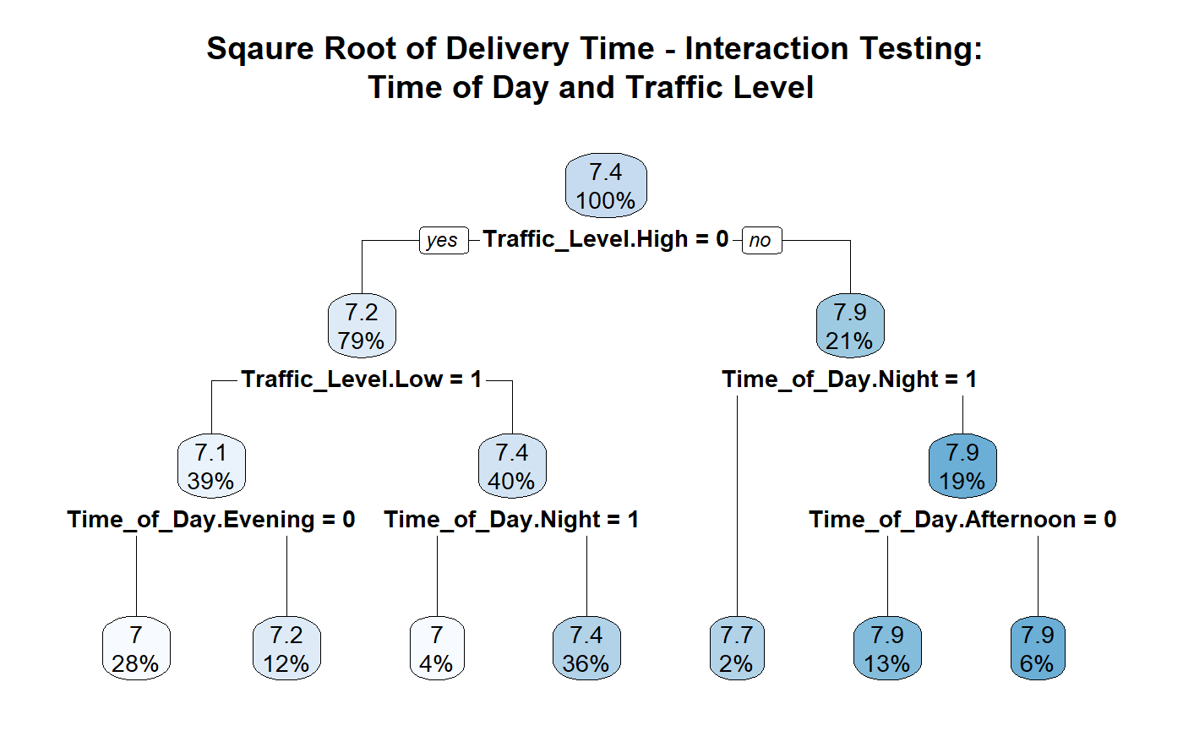
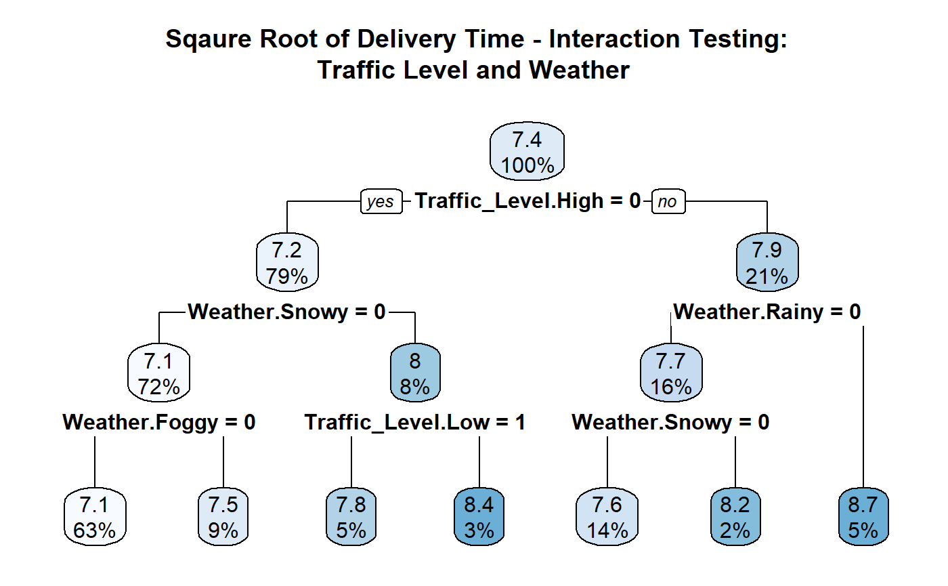
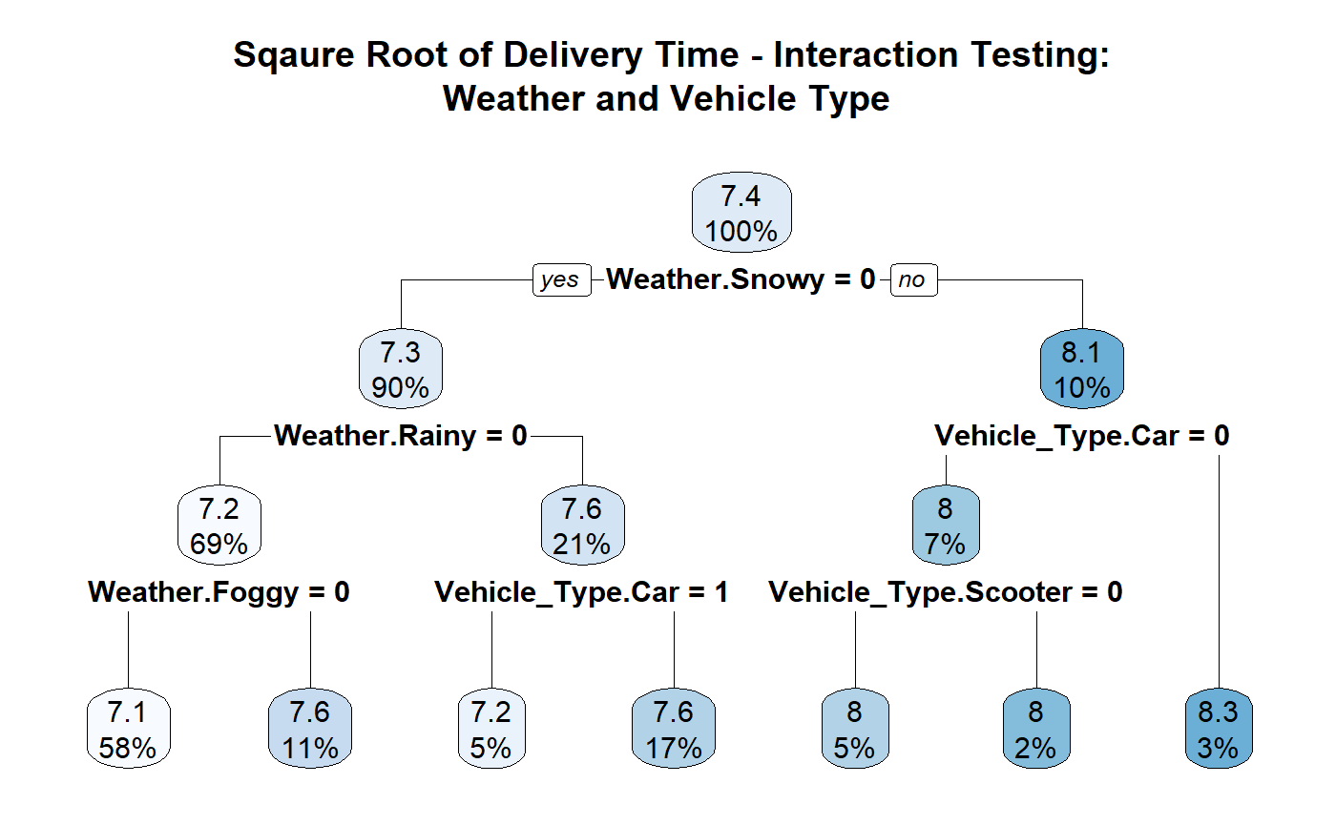
Interaction Testing
High traffic amplifies the effect of longer distances on delivery time
Snowy conditions interact with distance to worsen delivery times—due to reduced speed/safety
Traffic is only impactful when deliveries happen during busy daytime hours
When weather is already bad, traffic level doesn't further worsen things
Weather has different effects depending on vehicle type—scooters are more vulnerable to weather disruptions
Most sensitive pairs- Distance × Traffic, Weather × Distance, and Vehicle × Weather

Slide 12


And Analysis
Model Building

Slide 13
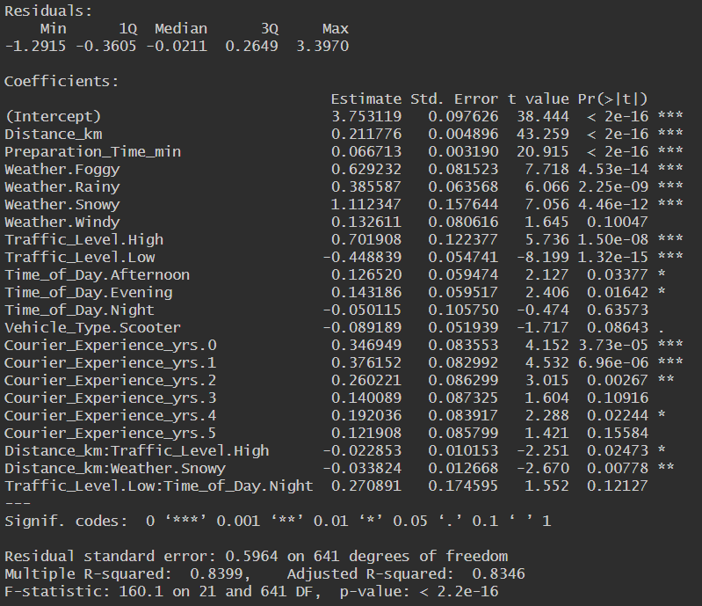
Backward Selection - AIC
model_full <- lm(Delivery_Time_min ~ . + Traffic_Level.High:Distance_km + Weather.Snowy:Distance_km + Traffic_Level.Low:Time_of_Day.Night +Vehicle_Type.Scooter:Weather.Rainy + Traffic_Level.Low:Weather.Foggy, data = data_train)
Backward Selected Model Summary
Full Model:
27 predictors
Performance Metric:
RMSE: 0.6714
Backward Selected Model:
6 predictors removed
Performance Metric:
RMSE: 0.6688

Slide 14
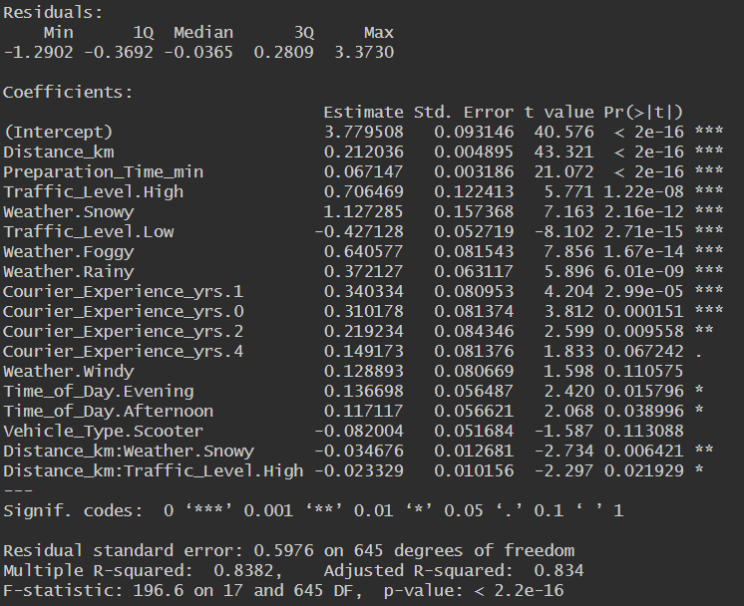
Forward Selection - AIC
Forward Selected Model Summary
Null Model:
Performance Metric:
RMSE: 1.4108
Forward Selected Model:
Removed 10 predictors
Performance metric:
RMSE: 0.6681
Best performing model out of the four options

Slide 15
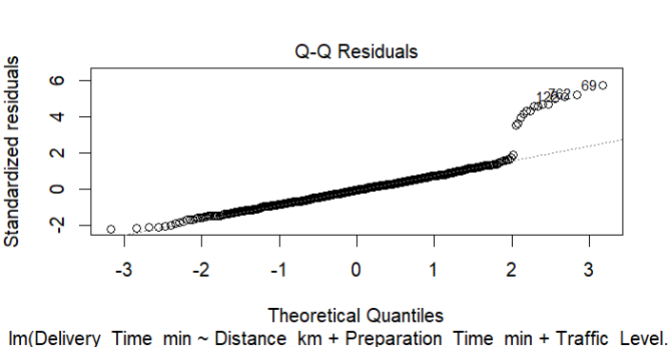
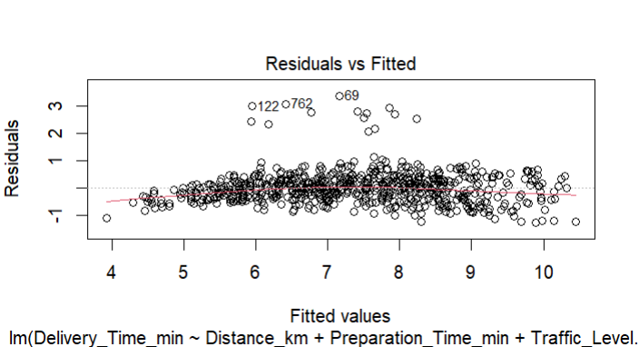
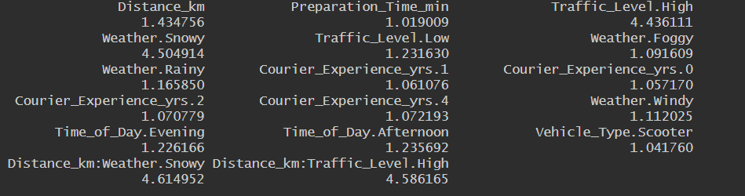

Forward Selected model - Model Diagnostics
Model Assumption Violations:
Homoscedasticity
Normality
Linearity
Durbin-Watson test indicated no violation of independence
VIF values indicated no violation of multicollinearity
Contains insignificant p-values
Outliers were checked and all observations were plausible
VIF Values
Durbin-Watson Test

Slide 16
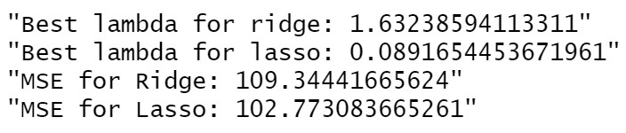
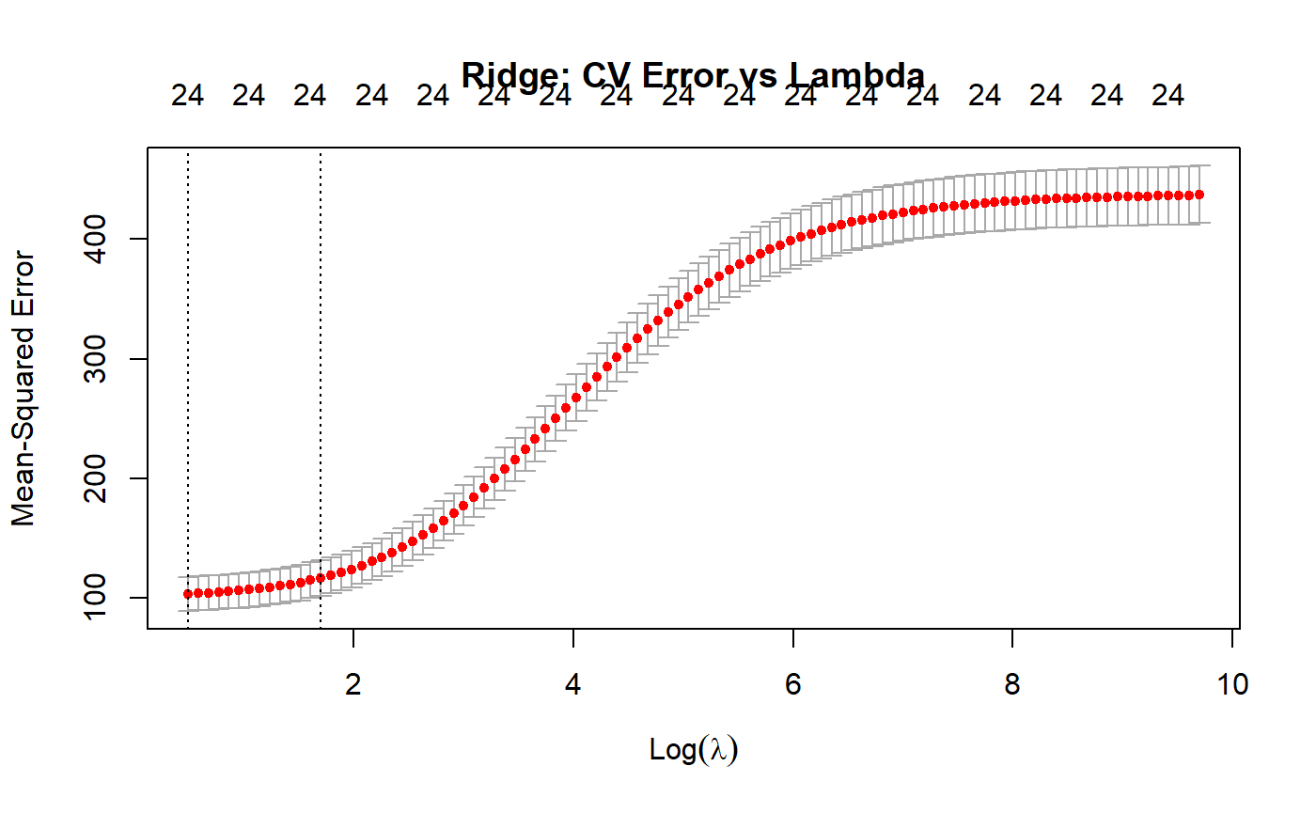
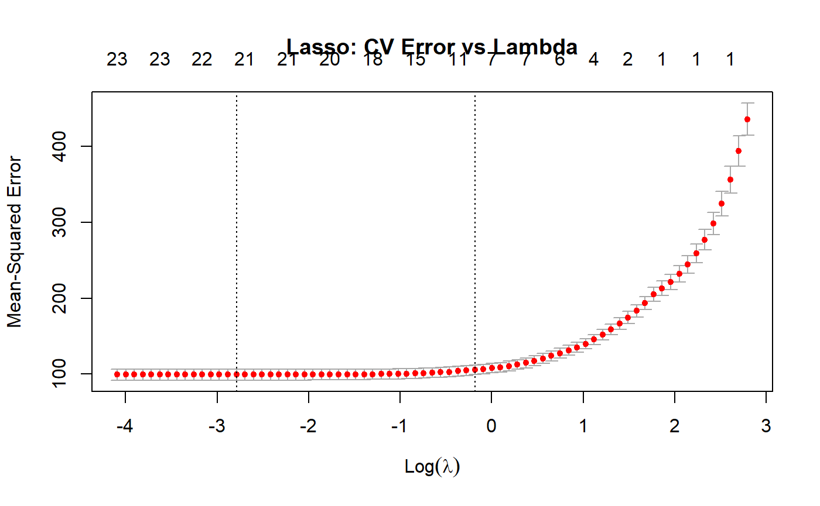
Ridge and Lasso Model
Lasso has a smaller lambda- model is using light regularization and performs better with less shrinkage
Lasso model's MSE is slightly lower suggesting that it is more accurate on the test set than ridge
Ridge Model is better for predictions so that would be the better of the two models

Slide 17
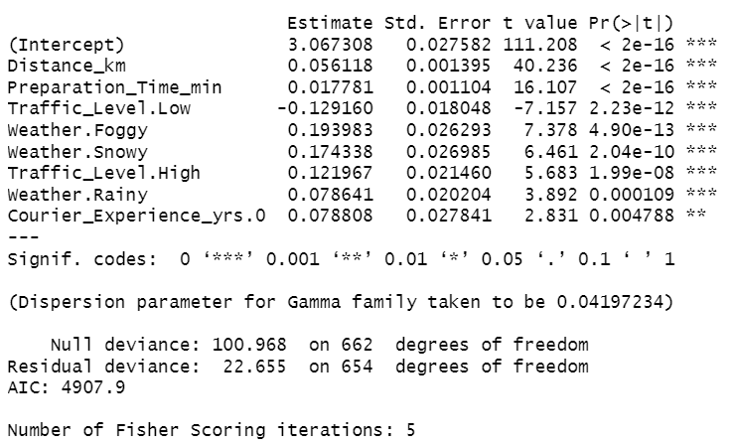
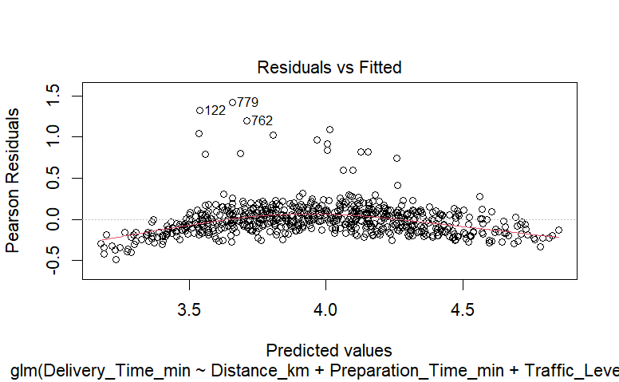
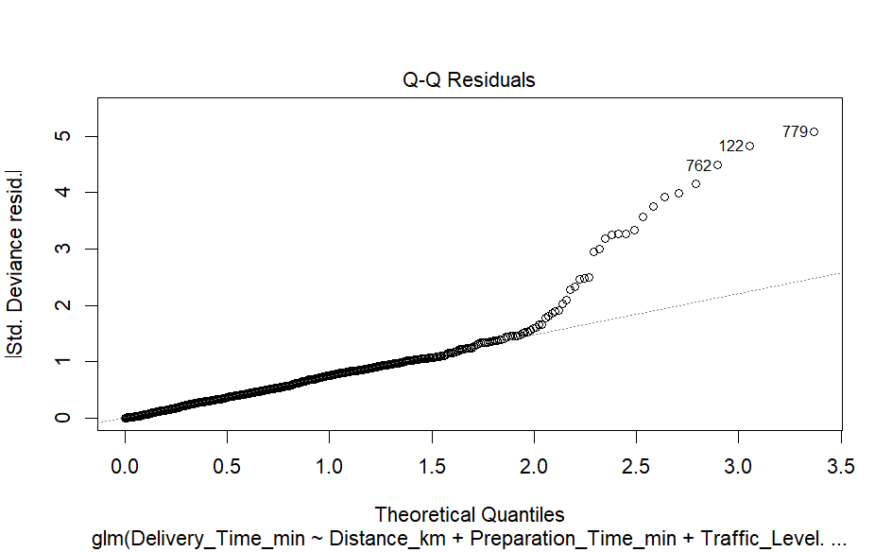
Generalized Linear Model
Tested Link Functions:
Gamma & Gaussian
No offset (Distance_km) used due to poor preliminary results
Used stepwise forward selection from a null model
AIC and BIC separately
glm(formula = Delivery_Time_min ~ Distance_km + Preparation_Time_min + Traffic_Level.Low + Weather.Foggy + Weather.Snowy + Traffic_Level.High + Weather.Rainy + Courier_Experience_yrs.0, family = Gamma(link = "log"), data = data_train)
Notes:
Model with offset had higher AIC, so offset was excluded from final models
Full models were fitted with all predictors for both Gamma and Gaussian GLMs

Slide 18
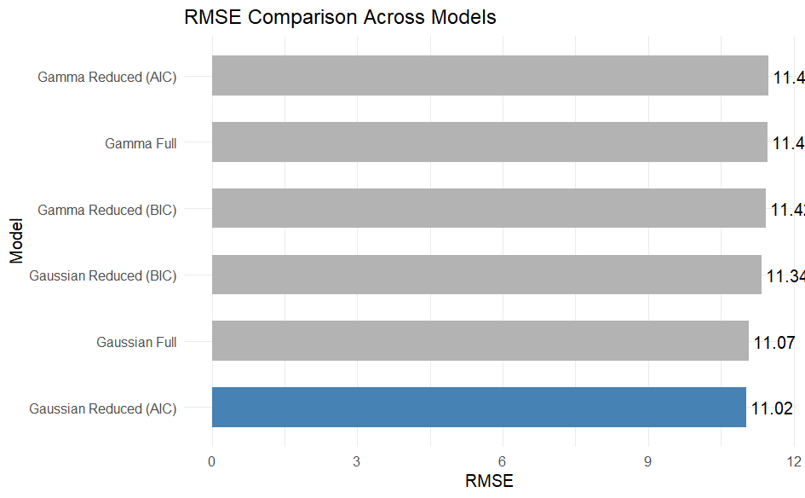
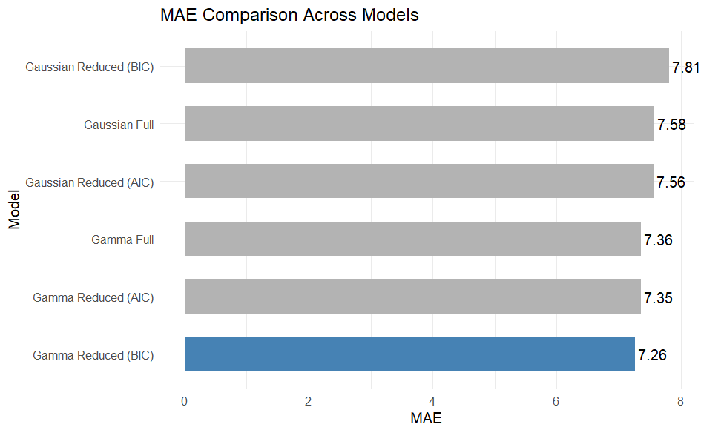


Generalized Linear Model
Notes:
Final Compared Models for Gamma and Gaussian families:
Full
AIC-reduced
BIC-reduced

Slide 19
Model Assumptions - Violations
Evaluated whether our models met key assumptions such as linearity, normality of residuals, and homoscedasticity.
Diagnostic Plots for the GLM indicated curvature and spread in the residuals.
Particularly in the Scale-Location and Q-Q Plots.

Slide 20

Conclusion
All models had similar RMSE (~0.618), indicating limited performance improvement.
Likely causes: multicollinearity and high dimensionality.
Next step: PCA to reduce dimensionality and remove redundancy.
Helps simplify the model, reduce overfitting, and improve prediction.

Slide 21
References
https://www.gloriafood.com/how-to-improve-food-delivery-service
https://www.jotform.com/blog/how-to-start-a-food-delivery-business/
https://stock.adobe.com/search?k=online+food+delivery
https://www.latimes.com/food/story/2021-03-03/food-delivery-service-app-fees-restaurants
https://spdload.com/blog/food-delivery-business-ideas/
https://www.gloriafood.com/marketing-strategy-for-food-delivery-service
https://spdload.com/blog/food-delivery-trends/

